Slide 1
CHAPTER 3
EVENTS

Slide 2


EXPLORE
ACTIVITY 1
10 MIN
Understand the code
Q1 When is the function writeMessage called ?
Q2 On which line number do we add a function where we click on the WRITE MESSAGE button ?
Update the code :
Q3 Add a new button “Clear message” to clear the message

Slide 3
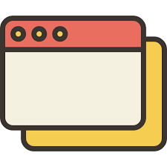
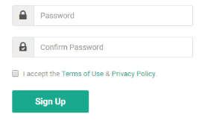

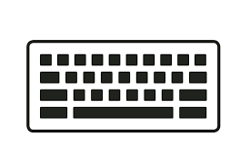
EXPLAIN
Focus on field
Form submitted
Events come from different sources
Mouse hover / pressed / moved
Key pressed / released

Slide 4
EXPLAIN
DEMO !!!!
10 MIN
Mouse over
https://www.w3schools.com/js/tryit.asp?filename=tryjs_imagemap
Simple click
https://www.w3schools.com/js/tryit.asp?filename=tryjs_events_onclick
Double click
https://www.w3schools.com/js/tryit.asp?filename=tryjs_events_ondblclick
Mouse move
https://www.w3schools.com/js/tryit.asp?filename=tryjs_events_onmousemove
Key pressed
https://www.w3schools.com/js/tryit.asp?filename=tryjs_events_onkeypress
Leave a field
https://www.w3schools.com/js/tryit.asp?filename=tryjs_events_onblur
Notes:
Demo of different events
Use : https://www.w3schools.com/js/js_events_examples.asp
Send them the link so they can try and see the list of events.
Go through a bunch of example, DON’T EXPLAIN MUCH, JUST SHOW

Slide 5
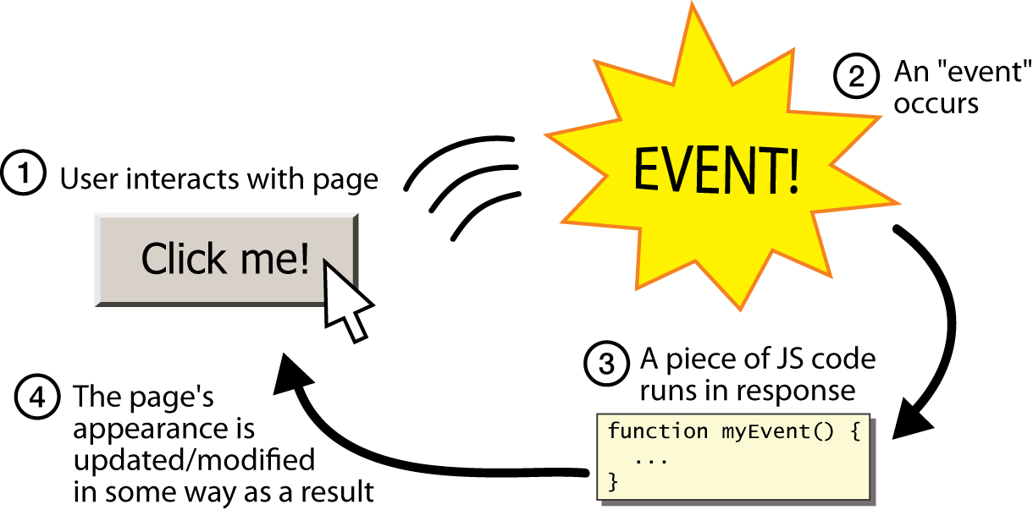
EXPLAIN
Listen to an event
And do something

Slide 6
Remember TKINTER
def myEventTrigger(event):
print("User has clicked at position : ", event.x, event.y)
canvas = tk.Canvas(frame)
canvas.create_oval(50, 50, 300, 300, fill="red", tags="PNCTarget")
canvas.tag_bind("PNCTarget","<Button-1>",myEventTrigger)
Use « tag_bind » to link a function with an event
<Button-1> = left button of mouse
<Button-3> = right button of mouse
The function to call everytime the event will happen
Set a tag to the shape.
Similar to ID in HTML
Notes:
Here remember the event is the last line, which calls the event handler « myEventTrigger »
You BIND a key to an event handler.
Here you have the same, except there are many components in a HTML page, you can bind events to the different compents..

Slide 7
EXPLAIN
Functions to access DOM elements
element.addEventListener(name,function) | Register an Event Handler, for the event name to the element, and the function to execute when the event happens.
element.removeEventListener(name,function) | Remove the Event Handler function for the event name from the element.
DEMO WITH CHROME
Notes:
Make a clear DEMO with any code, the one from the exercise is enough. Explain step by step each element.
TAKE YOUR TIME THIS STEP IS IMPORTANT

Slide 8
EXPLORE
ACTIVITY 2
10 MIN
Complete the 3 TODO !!
Notes:
Practice on adding simple events to a page
Introduce Event properties & AddEventListeners function
🡪 Change the color on click, display an alert on click over an image…

Slide 9
EXPLORE
ACTIVITY 3
10 MIN
Random COLOR!!
Notes:
Practice on adding simple events to a page
Introduce Event properties & AddEventListeners function
🡪 Change the color on click, display an alert on click over an image…

Slide 10
EXPLAIN
Get information from event
DO
DEMO
event.clientX | The X coordinate at which the event occured
event.clientY | The Y coordinate at which the event occured
event.target | a reference to the object related to the event

Slide 11
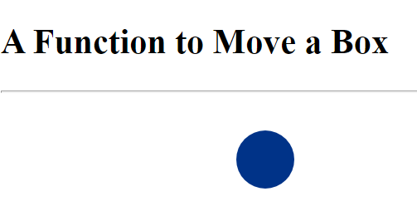
EXPLORE
ACTIVITY 4
10 MIN
Make the ball move with the mouse !
Notes:
Practice on adding simple events to a page
Introduce Event properties & AddEventListeners function
🡪 Change the color on click, display an alert on click over an image…

Slide 12
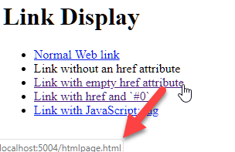
Cancel default actions
If you don’t need them !
DEFAULT ACTION =
REFRESH THE PAGE
DEFAULT ACTION =
OPEN NEW PAGE

Slide 13
Cancel default actions
If you don’t need them !
e.preventDefault() | default action that belongs to the event will not occur.

Slide 14
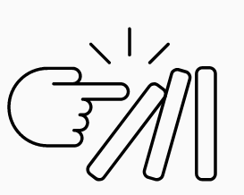
EXPLORE
ACTIVITY 5
10 MIN
Event Bubbling
Notes:
Practice on adding simple events to a page
Introduce Event properties & AddEventListeners function
🡪 Change the color on click, display an alert on click over an image…

Slide 15



Event Bubbling
When an event happens on an element :
it first runs the listeners on it
then on its parent
then all the way up on other ancestors.
1
2
3

Slide 16

Now you should know this:
1- Different kind of events (mouse, keys,,)
2- Add/Remove listeners to events
- addEventListener
-removeEventListener
3- Event properties
-event.target
- event.client
4- Default events / how to avoid them
- preventDefault
5- Events cascade mechanism
Notes:
List of events :
https://www.w3schools.com/jsref/dom_obj_event.asp

